Slide 1
CEIS110 Module 6
Develop Graphical Models and Interpret Results

Slide 2
Rubric
Activity | Requirement(s) | Points
Plot #1 | Picture/screenshot of plot from data with code | 15
Plot #2 | Picture/screenshot of plot from data with code | 15
Analysis | Question, plot, and answer | 15
Prediction | Prediction based on data | 15

Slide 3
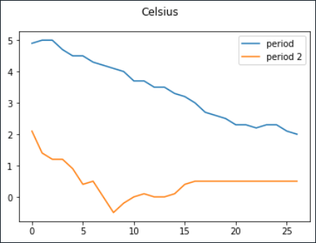
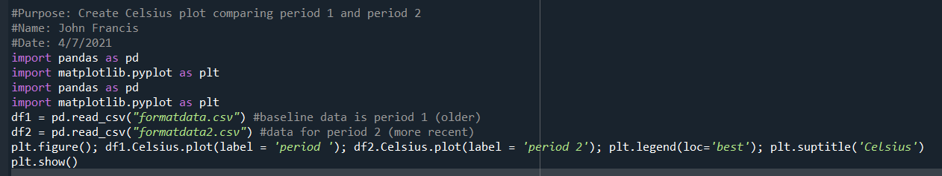
Plot #1
Plot and code used to generate it
Box
Line
Histogram
Scatter
Research your own!

Slide 4
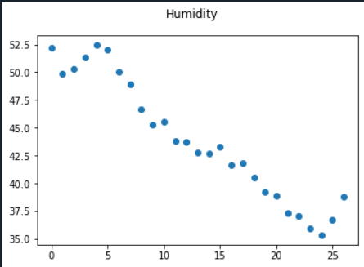
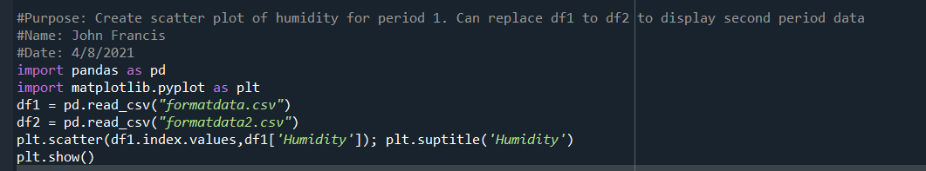
Plot #2 (Screenshots)
Plot and code used to generate it
Box
Line
Histogram
Scatter
Research your own!

Slide 5
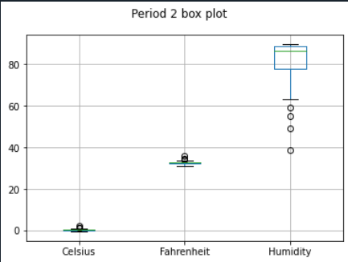
Analysis
Think of your own question and create a chart/graph to answer it
Your own question:
What was the range of humidity readings for the time frame shown?
Answer supported by Chart
65 to 98%

Slide 6
Prediction
Develop a prediction based on the data. What variations in temperature and humidity do you expect over the next few hours or days? How would humidity change if temperature goes up or down?
If temperature continues to decrease, then the humidity will continue to decrease.

